Slide 1

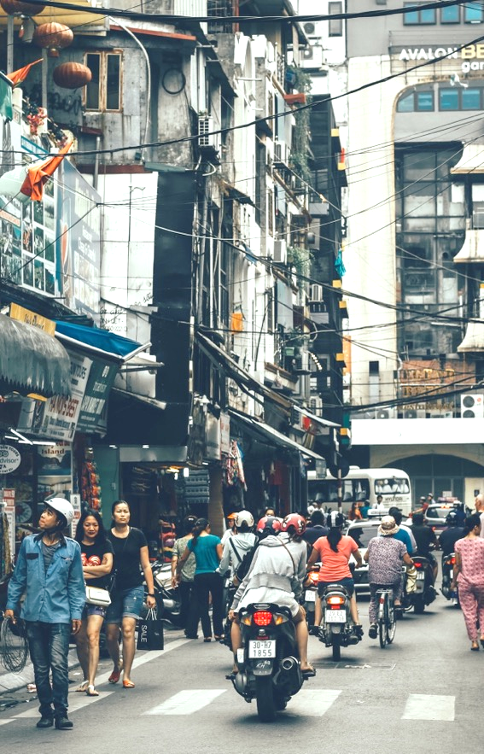
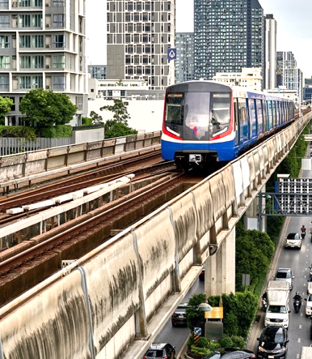

COP27
Tracking Transport and Climate Change Indicators in Asia and the Pacific
2000-2020
November 2022
Asian Transport Outlook

Slide 2
Outline
Hyperlinks only work in PowerPoint if using presentation mode
Transport CO2 Emissions 1990 -2050
Transport CO2 Emissions Growth Rate
Share of Asia Pacific countries with transport CO2 emissions growth rate
Infrastructure Growth
Number of Asian Cities with Rapid Urban Transit Infrastructure
Total Infrastructure Investment
PPP in Transport
Motorization in Asia (1)
Motorization in Asia (2)
Passenger and Freight Activity
Passenger Activity Mode Share
Freight Mode Share
Urban Transport Mode Share in Asia
Fuel Efficiency of First-time Registered LDVs (L/100km WLTC)
Fossil Fuel Subsidy in Transport Sector in Asia-Pacific
Transport Energy Consumption Share
Rail Electrification in Asia
Electric Vehicle Ownership in Asia
Countries with a biofuel mandate
Carbon Intensity of Transport in Asia-Pacific Region
Transport target coverage in NDCs and LTSs
Climate mitigation measures in NDC
Modal Share Targets
EV Targets
Climate adaptation measures
References to climate change in transport related policy documents
ADB Transport Projects with Climate Component
Summary shift in high-low carbon orientation in transport sector in Asia since 2000
ATO as tracker

Slide 3
Summary trends Transport and Climate Change in Transport in Asia and the Pacific

Slide 4
Transport CO2 Emissions 1990 -2050
<<< TOC
Good news - Transport CO₂ Emissions in Asia have deviated from historic (pre-2015) baseline. By 2050, we estimate that Transport CO2 emissions could be close to 50% lower than historic BAUs.
Bad news - At the current rate, transport CO2 emissions will not peak before 2050.
Requirement - For alignment with the 1.5 Degree or Net Zero pathways, transport CO2 emissions in Asia must peak by 2025 and reach below 1 Gt by 2050.
Source: Asian Transport Outlook. (2021). A New Perspective on Transport and Climate Change

Slide 5
Transport CO2 Emissions Growth Rate
<<< TOC
Scientific literature suggests that Asia’s transport CO2 emission baseline projections reduce over time.
The Asian Transport Outlook helps to explain why the transport sector baseline projections is reducing over time
Source: Asian Transport Outlook. (2021). A New Perspective on Transport and Climate Change

Slide 6
Share of Asia Pacific countries with transport CO2 emissions growth rate
<<< TOC
Since 2015, there has been a considerable decrease in the growth rate of transport CO2 emissions across the Asia Pacific region, with 59% of countries reporting growth of not more than 2%
The transport sector’s share in total fossil fuel CO2 emissions in Asia has reduced marginally, i.e. 2000=11.4%, 2015=11.8% & 2021=11.3%. This indicates that between 2015 and 2021, transport CO2 emissions in Asia is growing slightly slower than in other sectors.
Source: ATO Analysis based on EDGAR v7.0 Global Greenhouse Gas Emissions

Slide 7
Transport Infrastructure & Transport Activity
<<< TOC

Slide 8
Infrastructure Growth
<<< TOC
Road construction outpaces construction of rail infrastructure
Growth in BRT infrastructure has declined considerably, from a low baseline (in line with lack of general interest in bus expansion)
Metro construction is accelerating, as is the case of LRT
Source: ATO Analysis based on Country Official Statistics, UIC, and ITDP

Slide 9
Number of Asian Cities with Rapid Urban Transit Infrastructure
<<< TOC
Number of Asian cities with rapid urban transit infrastructure is increasing. But a significant gap remains.
Currently, only 125 cities out of about 550 cities with more than 0.5 million population have urban rapid transit.
Average size of rapid transit systems is increasing
Metro is a more popular choice compared to BRT or LRT.
Source: ATO Analysis based on ITDP

Slide 10
Total Infrastructure Investment
<<< TOC
Currently, 40% of Transport Inland Infrastructure investments (construction + maintenance) are allocated to Railways and Urban Transit
Source: Asian Transport 2030 Outlook

Slide 11
PPP in Transport
<<< TOC
PPP investments in transport infrastructure in Asia have increased, with 2016 –2020 growth limited by COVID in 2020.
PPP investments in transport infrastructure remain very limited compared to the overall investment
Noticeable is the continued absence of urban transit infrastructure data in the WB PPP database
Source: WB PPI

Slide 12
<<< TOC
Transport Activity

Slide 13
Motorization in Asia (1)
<<< TOC
Growth in passenger vehicle ownership is declining for 2&3- wheelers and cars.
Bad News – since 2015, growth in public transport vehicles ownership has almost completely stagnated
Freight Vehicles are growing faster over time
Source: ATO Analysis based on Country Official Statistics

Slide 14
Motorization in Asia (2)
<<< TOC
Good News - Since 2015, the trends confirm a significant decline in growth rate of private vehicle imports and a small decline in manufacturing in Asia
Bad News – there is a sharp decrease in the importation of buses which is in line with other negative trends regarding bus-based public transit systems
Source: ATO Analysis based on ITC Trade Map and OICA

Slide 15
Passenger and Freight Activity
<<< TOC
Over the last two decades, transport demand in Asia has more than doubled. Freight activity has outpaced growth of passenger transport activity
A relative decoupling of passenger & freight activity with GDP growth is visible in Asia
However, both Passenger & freight activity continue to grow faster than the population
Source: UN World Population Prospects, World Bank, ATO Analysis based on Country Official Statistics

Slide 16
Transport Mode Shares
<<< TOC

Slide 17
Passenger Activity Mode Share
<<< TOC
Despite several mode shift policies, Passenger activity is shifting away from buses (formal/informal) to 2-wheelers and cars
Rail passenger activity remains stable and is not increasing
Source: Asian Transport 2030 Outlook

Slide 18
Freight Mode Share
<<< TOC
Led by the People’s Republic of China’s inter-modal improvements, inland waterways/shipping mode share has increased.
Railway freight mode-share has remained the same.
Source: Asian Transport 2030 Outlook

Slide 19
Urban Transport Mode Share in Asia
<<< TOC
Active transport (walking and cycling) share is not growing
The share of private motorised transport (motorcycle and cars) is growing
Importance of both formal and informal public transport is declining rapidly
Shared mobility activity is gaining modestly in share
Source: ITF, 2021

Slide 20
Transport Fuels & Carbon Intensity
<<< TOC

Slide 21
Fuel Efficiency of First-time Registered LDVs (L/100km WLTC)
<<< TOC
Since 2005, the average fuel efficiency of new passenger cars sold in the global south (in terms of Lge/100km, WLTC) has improved from 8.4 in 2005 to 7.1 in 2019
In Asia, the rate of improvement in fuel efficiency of LDVs is picking up across almost all sub-regions of Asia, except Western Asia
However, the improvement is significantly lower than the 2.7% annual fuel economy improvements over 2005-2030 needed to meet the GFEI target
Source: UNEP

Slide 22
Fossil Fuel Subsidy in Transport Sector in Asia-Pacific
<<< TOC
Asia has made considerable progress in reducing fossil fuel subsidies
However, the 2022 crude oil price increase has resulted in reinstating subsidies in some leading oil-importing nations
Source: IEA Fossil Fuel Subsidy Database

Slide 23
Transport Energy Consumption Share
<<< TOC
Limited decrease in the role of oil in powering transport
Growth rates of non-oil energy sources is declining for natural gas and biofuel, while being stable in case of electricity
Source: IEA

Slide 24
Rail Electrification in Asia
<<< TOC
Considerable progress in the electrification of railways in Asia
We are on the verge of absolute decoupling of railway CO2 emissions with GDP
Source: ATO Analysis based on UIC

Slide 25
Electric Vehicle Ownership in Asia
<<< TOC
Good News – While the vehicle ownership growth rates have reduced, there is an exponential increase in electric vehicle ownership in Asia
Close to 95% of global electric vehicles are in Asia
Close to 92% of electric vehicles in Asia are 2&3- wheelers
Source: DNV

Slide 26
Countries with a biofuel mandate
<<< TOC
Less than 1/4th of Asian Economies have set Biofuel targets
Source: REN21

Slide 27
Carbon Intensity of Transport in Asia-Pacific Region
<<< TOC
There is a noticeable improvement in the carbon intensity of both passenger and freight transport in Asia. This improvement is across all modes
With growing electrification in railways, 2-3W and buses, carbon intensity may improve substantially in the coming years
Source: Asian Transport 2030 Outlook (forthcoming)

Slide 28
<<< TOC
Transport in Climate Policy Documents, LTS & NDC’s

Slide 29
Transport target coverage in NDCs and LTSs
<<< TOC
Average number of transport targets in NDC has not increased significantly since 2015.
LTSs on average has slightly more transport targets compared to NDCs.
(11)
(2)
(10)
(10)
Source: GIZ – SLOCAT Tracker, https://changing-transport.org/tracker-expert/

Slide 30
Climate mitigation measures in NDC
<<< TOC
Average no. of climate mitigation measures increased between initial and updated NDCs (5.2, 7.9)
Second generation NDCs have a lower number of transport measures (6.5)
‘Improve’ measures consistently dominate. Slight increase in ‘Shift’ measures
(30)
(25)
(4)
Average no. of climate mitigation measures per NDC
Source: GIZ – SLOCAT Tracker, https://changing-transport.org/tracker-expert/

Slide 31
Modal Share Targets
<<< TOC
There is a recent increase in the number of mode share targets in transport relate policy documents
Passenger related targets remain dominant
Overall the number of modal share targets, including their ambition level, is not likely to result in considerable modal share shift
Modal share target typology
Source: Asian Transport 2030 Outlook

Slide 32
EV Targets
<<< TOC
There is a gradual increase in the number of EV targets
Only ~13% of the targets are sourced from NDC/ LTS sources, which have not been all translated in national transport policy documents
Source: Asian Transport 2030 Outlook

Slide 33
Climate adaptation measures
<<< TOC
Generally, very few climate adaptation measures are seen in NDCs
Number of climate adaptation measures declining in second generation NDCs
(9)
(8)
(1)
Source: GIZ – SLOCAT Tracker, https://changing-transport.org/tracker-expert/

Slide 34
References to climate change in transport related policy documents
<<< TOC
Number of transport- related policy documents referring to ‘Climate Change’ have increased from 57% to 65% before and after 2016.
Source: ATO Analysis

Slide 35
ADB Transport Projects with Climate Component
<<< TOC
Majority of ADB Transport Projects have a climate change component
Mitigation is taking up a growing share of ADB climate funding in the transport sector
Source: ATO Analysis based on ADB

Slide 36
<<< TOC
Summary

Slide 37
Summary shift in high-low carbon orientation in transport sector in Asia since 2000
<<< TOC
HIGH CARBON
2000
LOW CARBON
Infrastructure
Motorization
Transport Demand
Passenger Mode Shift
Freight Mode Shift
Energy Efficiency
Fuel Decarbonisation
Transport Infrastructure Investment
Transport Climate Policies

Slide 38
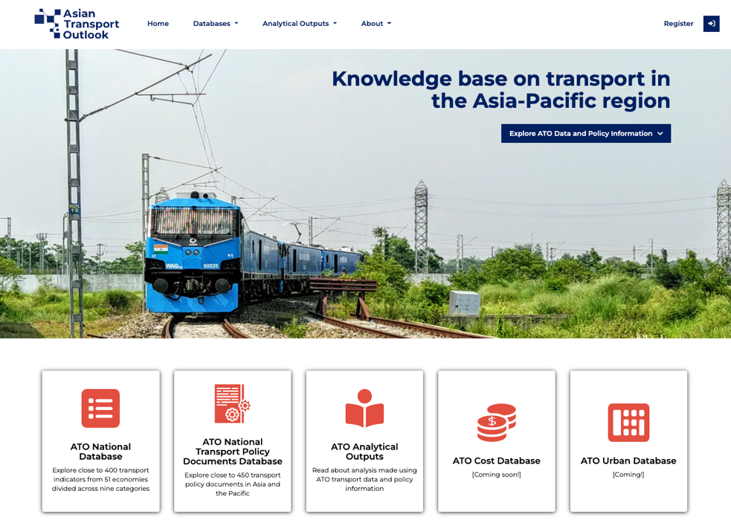
ATO as tracker
<<< TOC
ATO data and policy information is updated on an annual basis and can be used to track and document:
Transport CO2 emissions
Supportive trends in infrastructure, transport activity as well as transport energy
Transport policies
https://asiantransportoutlook.com/

Slide 39
<<< TOC
https://asiantransportoutlook.com/
“ATO translates data into insights, policies and investments”
Reach out to the team:
ATO Team – asiantransportoutlook@gmail.com
Jamie Leather - jleather@adb.org
Cornie Huizenga - chuizenga@cesg.biz
Sudhir Gota - sudhirgota@gmail.com
Subscribe to:
ATO newsletter – http://eepurl.com/hSB5KT
ATO Twitter - @transportATO
ADB Transport twitter - @adbtransport

